Slide 1
Boolean Algebra

Slide 2
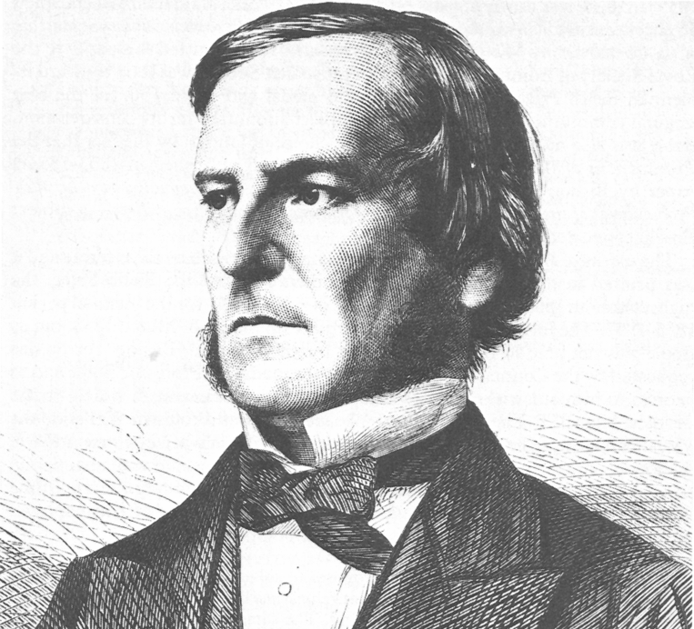
Boolean Algebra
George Boole introduced the mathematics of logical expressions in 1854.
Boolean functions demonstrate the logical relationship between binary variables.
Boolean laws allow simplification of logic design.
Notes:
Each of the laws are depicted with one or two variables. However, it can involve more than two variables for a single law while dealing with expressions. The laws detailed in this slide can be used to prove any Boolean expression. They ensure that complicated digital circuit is simplified. The reduction in the number of gates in a circuit result in the reduction in the number of connections. When the connections are fewer, the possibility of failure reduces and the circuits becomes cheaper to build. Understanding Boolean logical rules is fundamental to solving the logical expressions.

Slide 3



Boolean algebra Laws
Identity Laws
$$a∨0=a$$
$$a∧1=a$$
DOMINATION LAWS
$$a∨1=1$$
$$a∧0=0$$
Idempotent Laws
$$a∨a=a$$
$$a∧a=a$$
Double Negation
$$¬\left(¬a\right)=a$$
Commutative Laws
$$a∨b=b∨a$$
$$a∧b=b∧a$$
Associative Laws
$$\left(a∨b\right)∨c=a∨(b∨c)$$
$$\left(a∧b\right)∧c=a∧\left(b∧c\right)$$
Distributive Laws
$$a∨\left(b∧c\right)=\left(a∨b\right)∧\left(a∨c\right)$$
$$a∧\left(b∨c\right)=\left(a∧b\right)∨\left(a∧c\right)$$
De Morgan’s Laws
$$¬\left(a∨b\right)=¬a∧¬b$$
$$¬\left(a∧b\right)=¬a∨¬b$$
Notes:
Identity law implies that when a term is AND'ed with "1" or when a term is OR'ed with a "0" it will be equal to the term.
Annulment law implies that when AND is used between a term and "0", the value will be "0". When OR is used between a term and "1", the result will be "1".
The Idempotent law implies that when a term has AND and OR operator used with itself, the output will be the actual term.
The commulative law implies that the order in which two separate terms is not important when AND or OR operator is used.
The distributive allows the factoring or multiplying out of an expression with the AND and OR operator.
The associative law enables the removal of brackets from regrouping or an expression involving the variables.
The de Morgan's Theorem is two. The first one is weh tow different terms have the NOR operative used on them together, it is the same as when the two terms are inverted and the AND operator used on them. The second law is that when two separate terms have the NAND operator used on both of them, they are the same as the two terms inverted and an OR operator used on them. .

Slide 4

Truth Table for De Morgan’s Law
$$a$$ | $$b$$ | $$a∨b$$ | $$¬(a∨b)$$ | $$¬a$$ | $$¬b$$ | $$¬a∧¬b$$
1 | 1 | 1 | 0 | 0 | 0 | 0
1 | 0 | 1 | 0 | 0 | 1 | 0
0 | 1 | 1 | 0 | 1 | 0 | 0
0 | 0 | 0 | 1 | 1 | 1 | 1

Slide 5

Simplifying a Boolean Expression
Simplify $\left(b∨a\right)∧\left(b∨c\right)$
STEP 1 Apply Distributive Law
$$\left(\left(b∨a\right)∧b\right)∨\left(\left(b∨a\right)∧c\right)$$
Step 2 Apply Distributive Law
$$\left(\left(b∧b\right)∨\left(b∧c\right)\right)∨\left(\left(b∧a\right)∨\left(a∧c\right)\right)$$
Step 3 Apply Idempotent AND LAW
$$\left(b∨\left(b∧c\right)\right)∨\left(\left(b∧a\right)∨\left(a∧c\right)\right)$$
Step 4 Apply IDENTITY AND Law
$$\left(\left(b∧1\right)∨\left(b∧c\right)\right)∨\left(\left(b∧a\right)∨\left(a∧c\right)\right)$$

Slide 6

Simplifying a Boolean Expression
Step 5 Apply DISTRIBUTIVE LAW
$$\left(b∧\left(1∨c\right)\right)∨\left(\left(b∧a\right)∨\left(a∧c\right)\right)$$
Step 6 Apply Domination Law
$$(b∧1)∨\left(\left(b∧a\right)∨\left(a∧c\right)\right)$$
Step 7 Apply Identity AND Law
$$b∨\left(\left(b∧a\right)∨\left(a∧c\right)\right)$$
Step 8 Apply Associative Law
$$\left(b∨\left(b∧a\right)\right)∨(a∧c)$$

Slide 7

Simplifying a Boolean Expression
Step 9 Apply Identity And Law
$$\left(\left(b∧1\right)∨\left(b∧a\right)\right)∨(a∧c)$$
Step 10 Apply Distributive Law
$$\left(b∧\left(1∨a\right)\right)∨(a∧c)$$
Step 11 Apply Domination Law
$$\left(b∧1\right)∨\left(a∧c\right)$$
Step 12 Apply Identity And Law
$$b∨(a∧c)$$

Slide 8
Boolean logic allows us to model and simplify logic circuits.
Different laws are used to simplify existing functions.
Simplified functions reduce failure and cost.
Original Slides By Pelumi Apantaku.
Updated Slides by Kevin Chalmers.
Video By Kevin Chalmers.
Images courtesy of Wikimedia.

